Slide 1
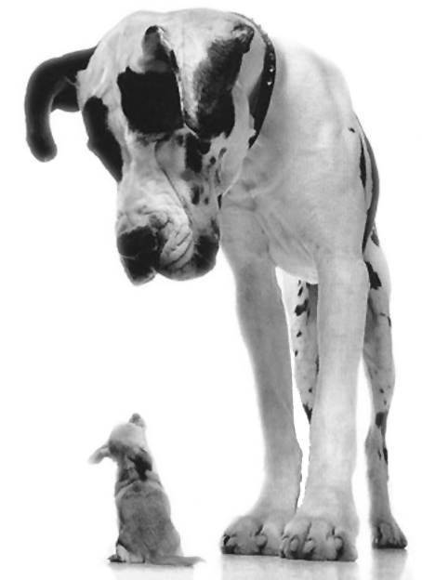
God’s Measure
Isaiah 55:8-9
Small and insignificant?
Not if God deems otherwise!

Slide 2
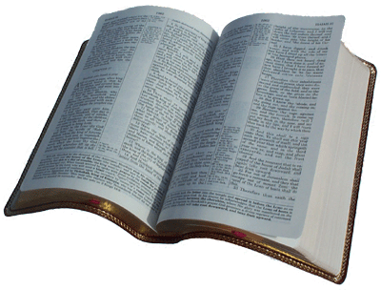
Isaiah 55:8-9
“For My thoughts are not your thoughts, nor are your ways My ways,” says the Lord. ⁹ “For as the heavens are higher than the earth, so are My ways higher than your ways, and My thoughts than your thoughts.”
Notes:
Want to emphasize that as we deal with our own relative insignificance, we are important to God.
This is clearly revealed in His word. It is His way!

Slide 3
Matthew 11:25-26
At that time Jesus answered and said, “I thank You, Father, Lord of heaven and earth, that You have hidden these things from the wise and prudent and have revealed them to babes. ²⁶ Even so, Father, for so it seemed good in Your sight.
Notes:
Jesus’ statement to the Father after upbraiding the cities of Chorazin, Bethsaida, and Capernaum for their unwillingness to believe despite the signs he had done among them.
God goes against the grain, showing favor on the humble and lowly, and confounding the wisdom of this world!
With this in mind… Consider these things that man perceive to be small and unimportant, but are great in God’s eyes!

Slide 4
Great Things in God’s Sight!
The gathering of His servants!
Matthew 18:19-20; Colossians 3:17

Slide 5
Matthew 18:19-20
“Again I say to you that if two of you agree on earth concerning anything that they ask, it will be done for them by My Father in heaven. ²⁰ For where two or three are gathered together in My name, I am there in the midst of them.”
Notes:
The power of communal prayer
The power of a well meant “amen”
God is with His people!
But, as next verse indicates, must be done with AUTHORITY… (in My name)

Slide 6
Colossians 3:17
And whatever you do in word or deed, do all in the name of the Lord Jesus, giving thanks to God the Father through Him.
Notes:
Always important to Note:
“in the name” does not indicate merely a mantra
When we gather AS AUTHORIZED BY CHRIST, He is with us!

Slide 7
Great Things in God’s Sight!
The gathering of His servants!
Matthew 18:19-20; Colossians 3:17
A cup of cold water!
Matthew 10:40-42; Hebrews 11:1-2

Slide 8
Matthew 10:40-42
“He who receives you receives Me, and he who receives Me receives Him who sent Me. ⁴¹ He who receives a prophet in the name of a prophet shall receive a prophet’s reward. And he who receives a righteous man in the name of a righteous man shall receive a righteous man’s reward. ⁴² And whoever gives one of these little ones only a cup of cold water in the name of a disciple, assuredly, I say to you, he shall by no means lose his reward.”
Notes:
Jesus’s words to his disciples, as He sent them out in the limited commission.
Application – Hospitality to those doing the Lord’s work! It is fellowship in that work!

Slide 9
Hebrews 11:1-2
Now faith is the substance of things hoped for, the evidence of things not seen. ² For by it the elders obtained a good testimony.
Notes:
Hebrews 11 shows a faith that is proven in obedience in things great and small…

Slide 10
Great Things in God’s Sight!
The gathering of His servants!
Matthew 18:19-20; Colossians 3:17
A cup of cold water!
Matthew 10:40-42; Hebrews 11:1-2
A disciple who perseveres!
Matthew 5:10-12; Hebrews 11:32-35

Slide 11
Matthew 5:10-12
Blessed are those who are persecuted for righteousness’ sake, for theirs is the kingdom of heaven. ¹¹ Blessed are you when they revile and persecute you, and say all kinds of evil against you falsely for My sake. ¹² Rejoice and be exceedingly glad, for great is your reward in heaven, for so they persecuted the prophets who were before you.

Slide 12
Hebrews 11:32-35
And what more shall I say? For the time would fail me to tell of Gideon and Barak and Samson and Jephthah, also of David and Samuel and the prophets: ³³ who through faith subdued kingdoms, worked righteousness, obtained promises, stopped the mouths of lions, ³⁴ quenched the violence of fire, escaped the edge of the sword, out of weakness were made strong, became valiant in battle, turned to flight the armies of the aliens. ³⁵ Women received their dead raised to life again.

Slide 13
Great Things in God’s Sight!
The gathering of His servants!
Matthew 18:19-20; Colossians 3:17
A cup of cold water!
Matthew 10:40-42; Hebrews 11:1-2
A disciple who perseveres!
Matthew 5:10-12; Hebrews 11:32-35
The little children!
Mark 10:13-16; Matthew 18:1-5

Slide 14
Mark 10:13-16
Then they brought little children to Him, that He might touch them; but the disciples rebuked those who brought them. ¹⁴ But when Jesus saw it, He was greatly displeased and said to them, “Let the little children come to Me, and do not forbid them; for of such is the kingdom of God. ¹⁵ Assuredly, I say to you, whoever does not receive the kingdom of God as a little child will by no means enter it.” ¹⁶ And He took them up in His arms, laid His hands on them, and blessed them.
Notes:
Emphasis for this passage. The tender love Jesus showed for the children.
“receive the kingdom as a little child” (Born again!, cf. John 3:3-5)

Slide 15
Matthew 18:1-5
At that time the disciples came to Jesus, saying, “Who then is greatest in the kingdom of heaven?” ² Then Jesus called a little child to Him, set him in the midst of them, ³ and said, “Assuredly, I say to you, unless you are converted and become as little children, you will by no means enter the kingdom of heaven. ⁴ Therefore whoever humbles himself as this little child is the greatest in the kingdom of heaven. 5 Whoever receives one little child like this in My name receives Me.”
Notes:
HUMILITY – as a little child.

Slide 16
Conclusion
Why does God use the small things?
1 Corinthians 1:26-31
Notes:
When small things are used (Like you and me) GOD GETS THE GLORY (cf. vs. 31)
Saved by grace, not works!

